Slide 1

Python Arrays neural networks
PYTHON
洪振聰

Slide 2
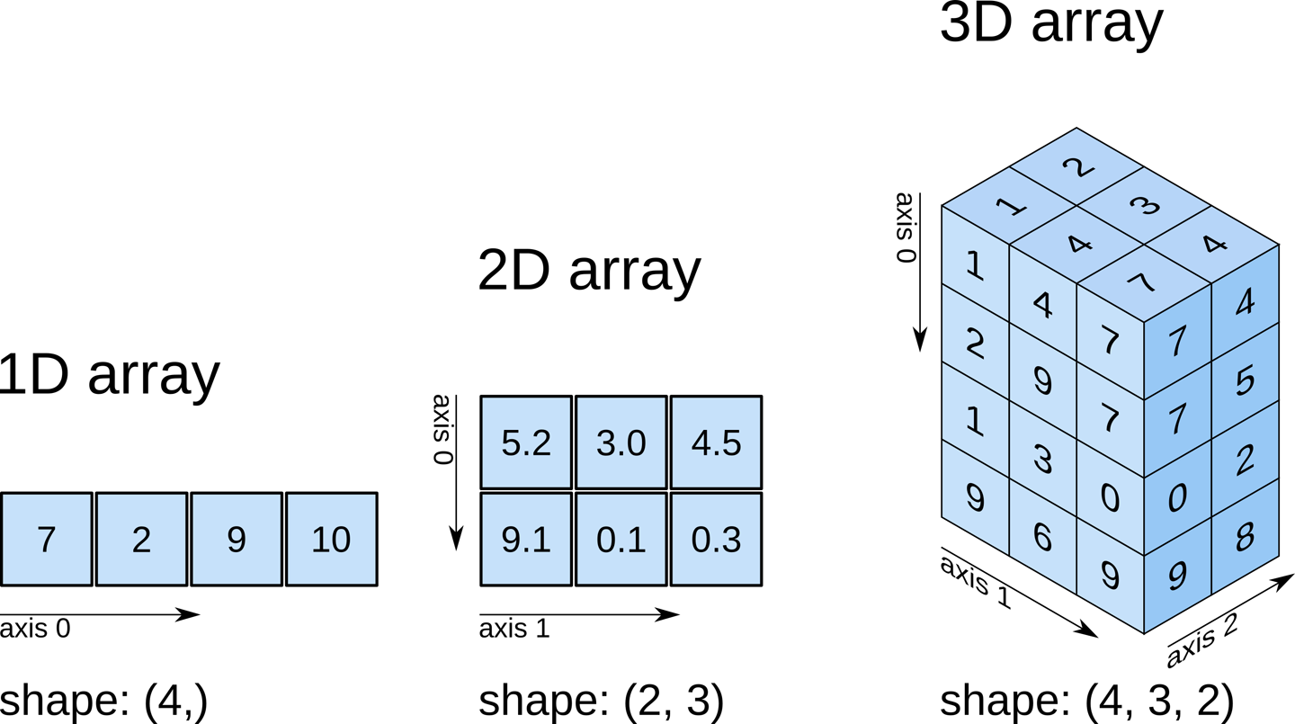

Slide 3
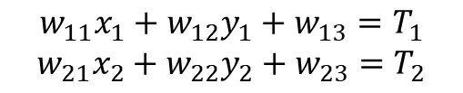
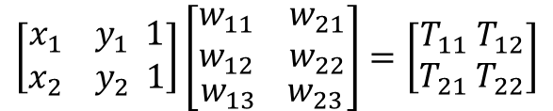

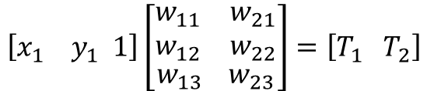
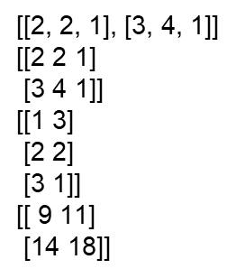











import numpy as np
lxy=[[2,2],[3,4]]
w=[[1,2,3],[3,2,1]]
for x in lxy:
x.append(1)
print(lxy)
arxy=np.array(lxy)
wt=np.array(w)
print(arxy)
print(wt.T)
print(np.dot(arxy,wt.T))
x1
y1
1

Slide 4

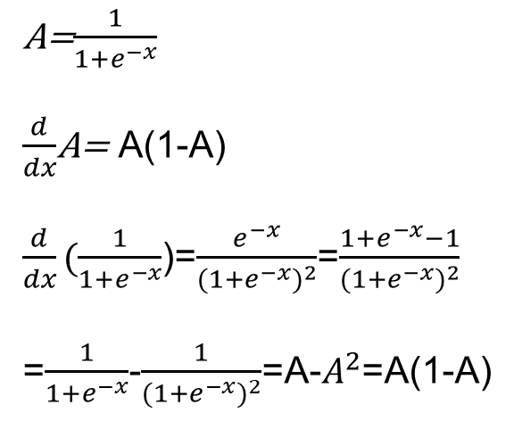
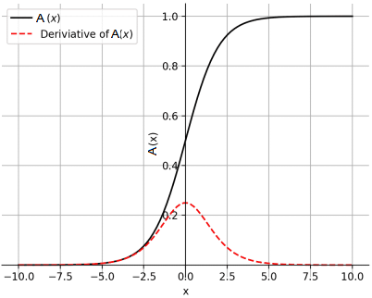
sigmoid function
Sigmoid 函數係邏輯函數（logistic function）：
A
import numpy as np
def nonlin(x,deriv=False):
A=1/(1+np.exp(-x))
if(deriv==True):
return (A*(1-A))
return A
print(nonlin(0,0))

Slide 5



Atifical Neural Network
husthung.blogspot.com
0,0,1 ->0 1,0,1 ->1
Input |  |  | output
0 | 0 | 1 | 0
1 | 1 | 1 | 1
1 | 0 | 1 | 1
0 | 1 | 1 | 0
1 | 0 | 0 | ?
1,1,1 ->1 0,1,1 ->0

Slide 6
import csv
import numpy as np
import pandas as pd
url = "https://raw.githubusercontent.com/husthorng/hello-world/neural/trainingdata.csv"
import numpy as np
def nonlin(x,deriv=False):
A=1/(1+np.exp(-x))
if(deriv==True):
return (A*(1-A))
return A
# print(nonlin(0,1))
numTag=2
records = pd.read_csv(url,encoding='utf-8')
# print(records.shape)
inputD=records.iloc[0:records.shape[0],0:records.shape[1]-numTag].values
targetD=records.iloc[:,list(records.shape[1]-np.arange(numTag,0,-1))].values
print(inputD)
print(targetD)
np.random.seed(1)
syn0=2*np.random.random((inputD.shape[1],4))-1
syn1=2*np.random.random((4,numTag))-1
print(syn0)
print(syn1)

Slide 7
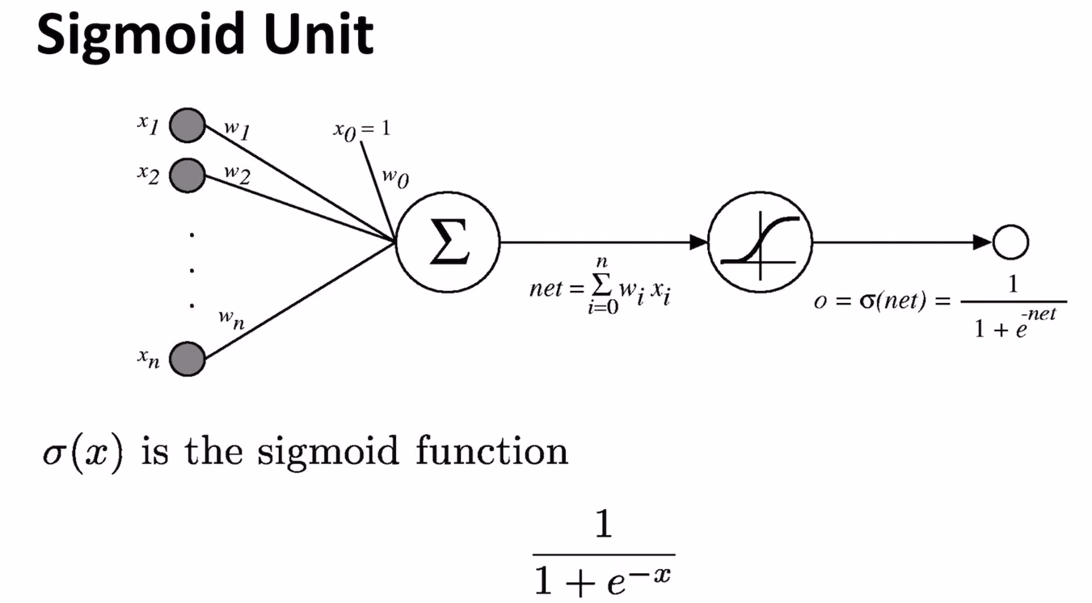

Slide 8
import numpy as np
def nonlin(x,deriv=False):
if(deriv==True):
return (x*(1-x))
return 1/(1+np.exp(-x))
x=np.array([[0,0,1],
[0,1,1],
[1,0,1],
[1,1,1]])
y=np.array([[0],
[1],
[1],
[0]])
#seed
np.random.seed(1)
#Synapses
syn0=2*np.random.random((3,4))-1
syn1=2*np.random.random((4,1))-1
#Training
for j in range(6):
#layer
l0=x
l1=nonlin(np.dot(l0,syn0))
l2=nonlin(np.dot(l1,syn1))
#backpropagation
l2_error=y-l2
if(j % 1000)==0:
print("Error"+str(np.mean(np.abs(l2_error))))
l2_delta=l2_error*nonlin(l2,deriv=True)
l1_error=l2_delta.dot(syn1.T)
l1_delta=l1_error*nonlin(l1,deriv=True)
syn1 += l1.T.dot(l2_delta)
syn0 += l0.T.dot(l1_delta)
#print output
print("output after Training:")
print(l2)

Slide 9
import csv
import numpy as np
import pandas as pd
url = "https://raw.githubusercontent.com/husthorng/hello-world/neural/trainingdata.csv"
import numpy as np
def nonlin(x,deriv=False):
A=1/(1+np.exp(-x))
if(deriv==True):
return (A*(1-A))
return A
# print(nonlin(0,1))
numTag=1
hidden_node=5
records = pd.read_csv(url,encoding='utf-8')
#print(records.shape)
inputD=records.iloc[0:records.shape[0],0:records.shape[1]-numTag].values
print(inputD.shape)
targetD=records.iloc[:,list(records.shape[1]-np.arange(numTag,0,-1))].values
#print(inputD)
#print(targetD)
np.random.seed(1)
syn0=2*np.random.random((inputD.shape[1],hidden_node))-1
syn1=2*np.random.random((hidden_node,numTag))-1
# print(syn0)
# print(syn1)
for j in range(60):
X=inputD
L0=nonlin(np.dot(inputD,syn0))
L1=nonlin(np.dot(L0,syn1))
#print(L1)
L1_error=targetD-L1
if(j % 10)==0:
print("Error"+str(np.mean(np.abs(L1_error))))
#print(L1_error)
L1_delta=L1_error*nonlin(L1,deriv=True)
#print(L1_delta)
L0_error=L1_delta.dot(syn1.T)
L0_delta=L0_error*nonlin(L0,deriv=True)
syn1 += L0.T.dot(L1_delta)
syn0 += inputD.T.dot(L0_delta)
print("output after Training:")
print(L1)
df = pd.DataFrame(syn0)
print(df)
df.to_csv("syn0.csv")
# https://github.com/husthorng/hello-world/tree/neural
import csv
import numpy as np
import pandas as pd
import numpy as np
def nonlin(x,deriv=False):
A=1/(1+np.exp(-x))
if(deriv==True):
return (A*(1-A))
return A
# print(nonlin(0,1))
url = "https://raw.githubusercontent.com/husthorng/hello-world/neural/syn0.csv"
syn0t=pd.read_csv(url,encoding='utf-8')
syn0=syn0t.values[0:,1:]
url = "https://raw.githubusercontent.com/husthorng/hello-world/neural/syn1.csv"
syn1t=pd.read_csv(url,encoding='utf-8')
syn1=syn1t.values[0:,1:]
numTag=syn1.shape[1] #
hidden_node=syn0.shape[0]
url = "https://raw.githubusercontent.com/husthorng/hello-world/neural/trainingdata.csv"
records = pd.read_csv(url,encoding='utf-8')
inputD=records.iloc[0:records.shape[0],0:records.shape[1]-numTag].values
tagetD=records.iloc[:,list(records.shape[1]-np.arange(numTag,0,-1))].values
print("\n ============input data:=========== ")
print(inputD)
print("\n ============layer 0 weight:=======")
print(syn0)
print("\n=============layer 1 weight:=======")
print(syn1)
# print(nonlin(inputD.dot(syn0)))
L0OT=nonlin(inputD.dot(syn0))
L1OT=nonlin(L0OT.dot(syn1))
df = pd.DataFrame(L1OT)
df[df>0.5]=1
df[df<0.5]=0
print("\n=======output value:=======")
print(df.values)

Slide 10
import numpy as np
vartab=[[0,10],[1,11],[2,12],[3,13],[4,14],[5,15],[6,10],[7,11],[8,12],[9,13],[10,14]]
Const_A=3
vartab.insert(0,[0,Const_A])
def myfun(st,ev):
sum=0
x=st
xmax=ev
step=0.01
while True:
y=Const_A/(np.exp(-x)+1)-np.sin(x)+1
sum+=step*y
x+=step
if x > xmax:
break
return sum;
for x in vartab:
print(myfun(x[0],x[1]))
8.10742249101133
36.116851627279026
38.561146209279435
40.915570311485446
41.788149205704194
40.77448769191489
38.97795608714274
14.237561671466672
15.289546474027617
17.02608890408746
17.854035147450556
17.013433287639646

Slide 11
 | 0 | 1 | 2 | 3 | 4 |  | 19 | 20 | 21 | 22 | 23
0 | 1 | 2 | 3 | 4 | 5 |  | 20 | 21 | 22 | 23 | 24
1 | 1.163472 | 3.452163 | 8.107422 | 15.6898 | 25.90363 |  | 405.4997 | 445.8478 | 488.6957 | 534.463 | 582.7241
2 | 17.48806 | 26.80246 | 36.11685 | 45.43125 | 54.74564 |  | 194.4616 | 203.776 | 213.0904 | 222.4048 | 231.7192
3 | 19.17033 | 28.86574 | 38.56115 | 48.25655 | 57.95196 |  | 203.3831 | 213.0785 | 222.7739 | 232.4693 | 242.1647
4 | 21.15061 | 31.03309 | 40.91557 | 50.79805 | 60.68053 |  | 208.9178 | 218.8002 | 228.6827 | 238.5652 | 248.4477
5 | 21.86579 | 31.82697 | 41.78815 | 51.74933 | 61.7105 |  | 211.1282 | 221.0893 | 231.0505 | 241.0117 | 250.9729
6 | 20.79097 | 30.78273 | 40.77449 | 50.76625 | 60.75801 |  | 210.6344 | 220.6262 | 230.6179 | 240.6097 | 250.6015
7 | 18.97145 | 28.9747 | 38.97796 | 48.98121 | 58.98446 |  | 209.0332 | 219.0365 | 229.0397 | 239.043 | 249.0462
8 | 6.222447 | 10.23 | 14.23756 | 18.24512 | 22.25268 |  | 82.36603 | 86.37359 | 90.38115 | 94.3887 | 98.39626
9 | 7.271345 | 11.28045 | 15.28955 | 19.29865 | 23.30775 |  | 83.44426 | 87.45336 | 91.46246 | 95.47156 | 99.48066
10 | 9.006751 | 13.01642 | 17.02609 | 21.03576 | 25.04543 |  | 85.19046 | 89.20013 | 93.2098 | 97.21947 | 101.2291
11 | 9.834279 | 13.84416 | 17.85404 | 21.86391 | 25.87379 |  | 86.02197 | 90.03184 | 94.04172 | 98.0516 | 102.0615
12 | 8.993523 | 13.00348 | 17.01343 | 21.02339 | 25.03334 |  | 85.18267 | 89.19263 | 93.20258 | 97.21254 | 101.2225

Slide 12


